Slide 1
Accredited Standards Committee C63® - EMC
Subcommittee 8
Stephen Berger
Chair
2024-05-10

Slide 2
Accredited Standards Committee C63® - EMC
Scope of Subcommittee 8
(unchanged from last year)
Subcommittee 8 is responsible for writing and maintaining existing and proposed C63® standards for medical devices, as assigned by the Main Committee ANSC 63®.

Slide 3
Accredited Standards Committee C63® - EMC
Membership of Subcommittee 8
Changes since last meeting:
Yasaman Ardeshirpour has applied to become a member of SC8. Her application has been approved by the SC members and is recommended to the Parent Committee.
Total members – 9
3

Slide 4
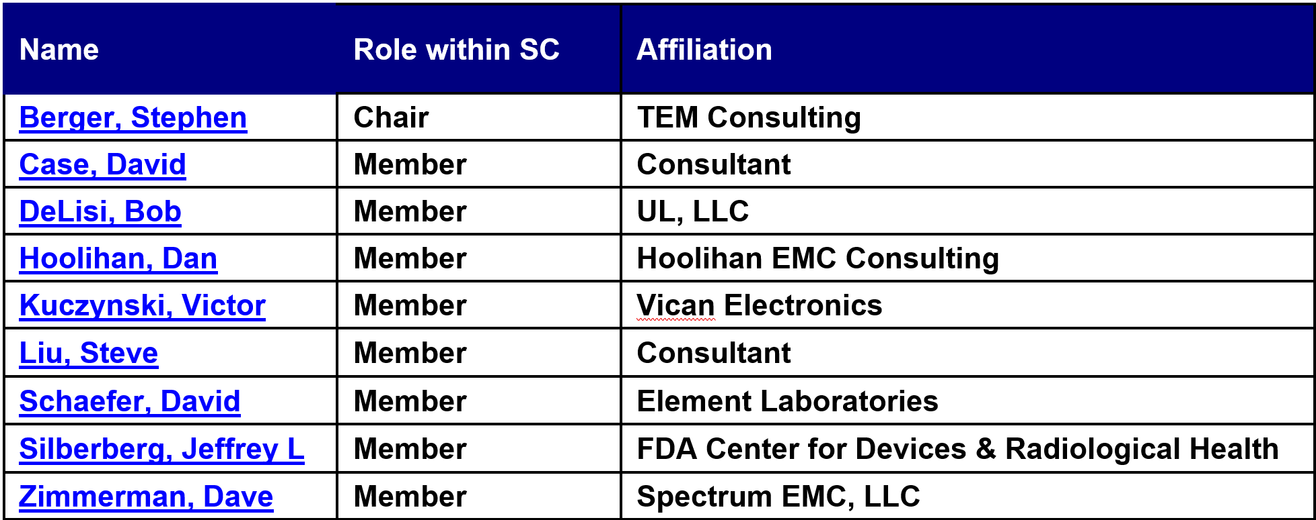
Accredited Standards Committee C63® - EMC
Current Membership of Subcommittee 8
4

Slide 5
Accredited Standards Committee C63® - EMC
Subcommittee 8 Duties SC8 Developed and Maintains the following Standards
C63.18 - American National Recommended Practice for an On-Site, Ad Hoc Test Method for Estimating Electromagnetic Immunity of Medical Devices to Radiated Radio-Frequency (RF) Emissions from RF Transmitters
C63.19 - American National Standard Methods of Measurement of Compatibility between Wireless Communications Devices and Hearing Aids
PC63.33 - Draft American National Standard
Standard for Evaluating Immunity of Portable Electronic Medical Devices to Electronic Article Surveillance (EAS) Systems and Metal Detectors

Slide 6
Accredited Standards Committee C63® - EMC
C63.18 On-site immunity testing of medical equipment
Document reaffirmed: July 22, 2019

Slide 7
Accredited Standards Committee C63® - EMC
WG-2 C63.19 - Hearing Aid compatibility
New version published: November 19, 2019

Slide 8
Accredited Standards Committee C63® - EMC
WG-2 C63.33 - Immunity to EAS
Meeting by Webex every 2 weeks.

Slide 9
Accredited Standards Committee C63® - EMC
Motion from SC8
SC8 recommends that C63 approve the scope, membership, with the addition of Yasaman Ardeshirpour, and duties, as presented.

